Slide 1
AZ-104T00A Module 06: Network Traffic Management

Slide 2
Module Overview
Lesson 01: Azure Load Balancer
Lesson 02: Module 06 Lab and Review
Notes:
Module overview

Slide 3
Lesson 02: Azure Load Balancer

Slide 4
Azure Load Balancer Overview
Azure Load Balancer
Public Load Balancer
Internal Load Balancer
Load Balancer SKUs
Backend Pools
Load Balancer Rules
Session Persistence
Health Probes
Notes:
Lesson overview

Slide 5
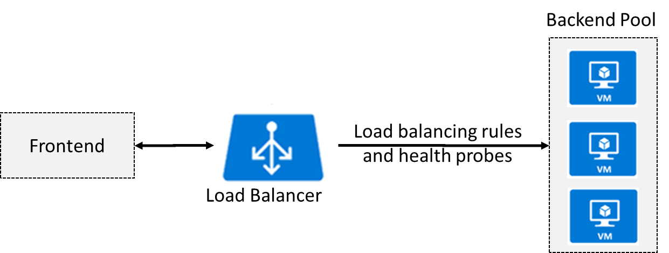
Azure Load Balancer
Distributes inbound traffic to backend resources using load-balancing rules and health probes
Can be used for both inbound/outbound scenarios
Extend Active Directory to the cloud
Two types: Public and Internal
Notes:
✔ Keep this diagram in mind since it covers the four components that must be configured for your load balancer: Frontend IP configuration, Backend pools, Health probes, and Load balancing rules.
Load Balancer documentation - https://docs.microsoft.com/en-us/azure/load-balancer/

Slide 6
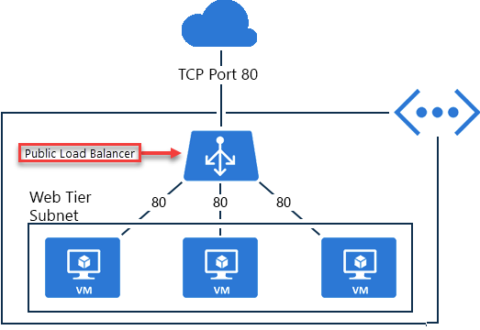
Public Load Balancer
Maps public IP addresses and port number of incoming traffic to the VM’s private IP address and port number, and vice versa.
Apply load balancing rules to distribute traffic across VMs or services.

Slide 7
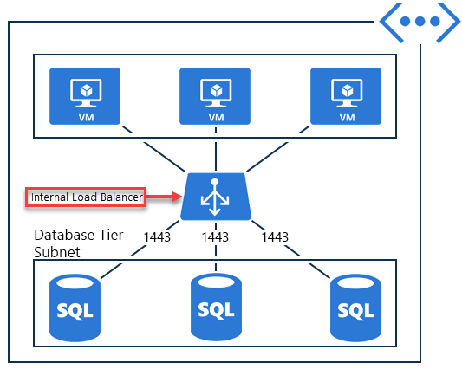
Internal Load Balancer
Directs traffic only to resources inside a virtual network or that use a VPN to access Azure infrastructure.
Frontend IP addresses and virtual networks are never directly exposed to an internet endpoint.
Enables load balancing within a virtual network, for cross-premises virtual networks, for multi-tier applications, and for line-of-business applications.
Notes:
✔ Can you see how a public load balancer could be placed in front of the internal load balancer to create a multi-tier application.

Slide 8
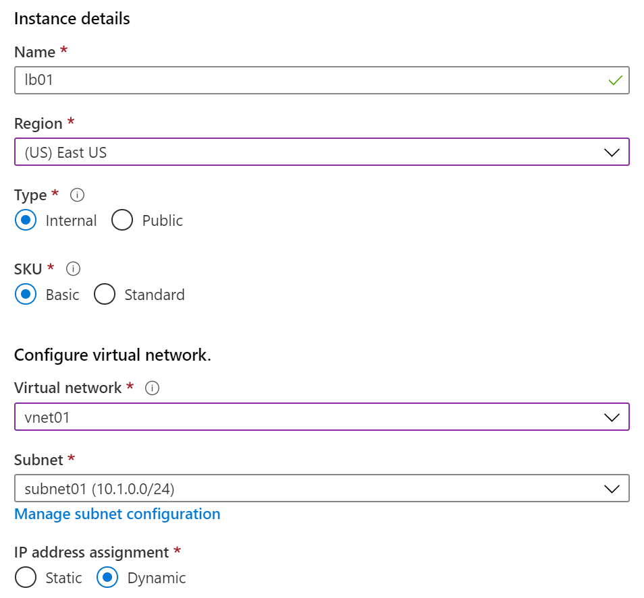
Load Balancer SKUs
Load balancer supports both Basic and Standard (newer) SKUs
SKUs are not mutable
Load Balancer rule cannot span two virtual networks
No charge for the Basic Load Balancer SKU
Load Balancer frontends are not accessible across global virtual network peering

Slide 9
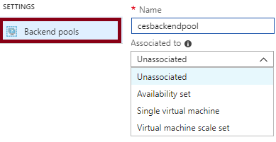
Backend Pools
SKU | Backend pool endpoints
Basic SKU | VMs in a single availability set or VM scale set.
Standard SKU | Any VM in a single virtual network, including a blend of VMs, availability sets, and VM scale sets.
To distribute traffic, a back-end address pool contains the IP addresses of the virtual NICs that are connected to the load balancer
Notes:
✔ In the Standard SKU you can have up to 1000 instances in the backend pool. In the Basic SKU you can have up to 100 instances.

Slide 10
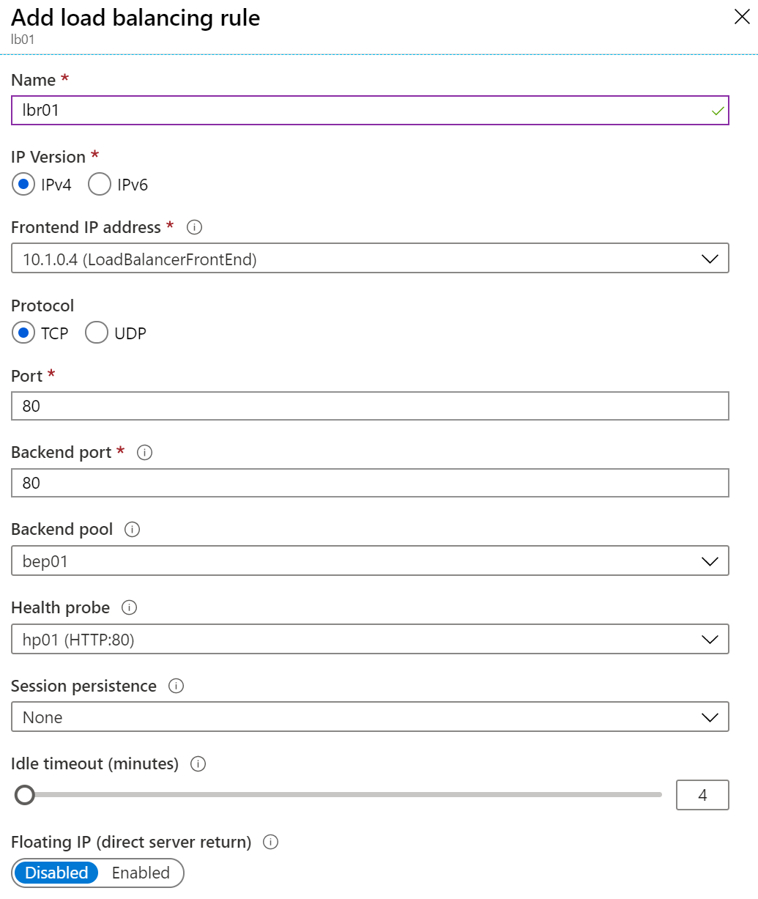
Load Balancer Rules
Maps a frontend IP and port combination to a set of backend IP addresses and port combination
Rules can be used in combination with NAT rules
A NAT rule is explicitly attached to a VM (or network interface) to complete the path to the target
Notes:
✔ Can you see the difference between load balancing rules and NAT rules? Remember, this approach should only be used when you need connectivity from the Internet. Most normal communications would occur from on-premises to Azure connections such as site-to-site VPN and ExpressRoute.

Slide 11
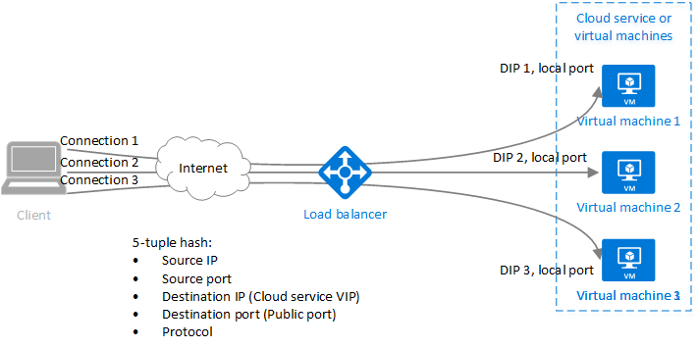
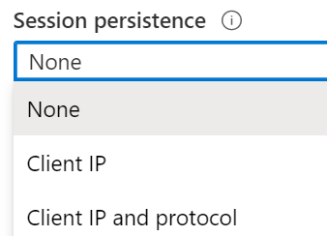
Session Persistence
Session persistence specifies how client traffic is handled
Client IP (default) requests can be handled by any virtual machine
Client IP and protocol specifies that successive requests from the same address and protocol will be handled by the same virtual machine
Notes:
✔Keeping session persistence information is very important in applications that use a shopping cart. Can you think of any other applications?

Slide 12
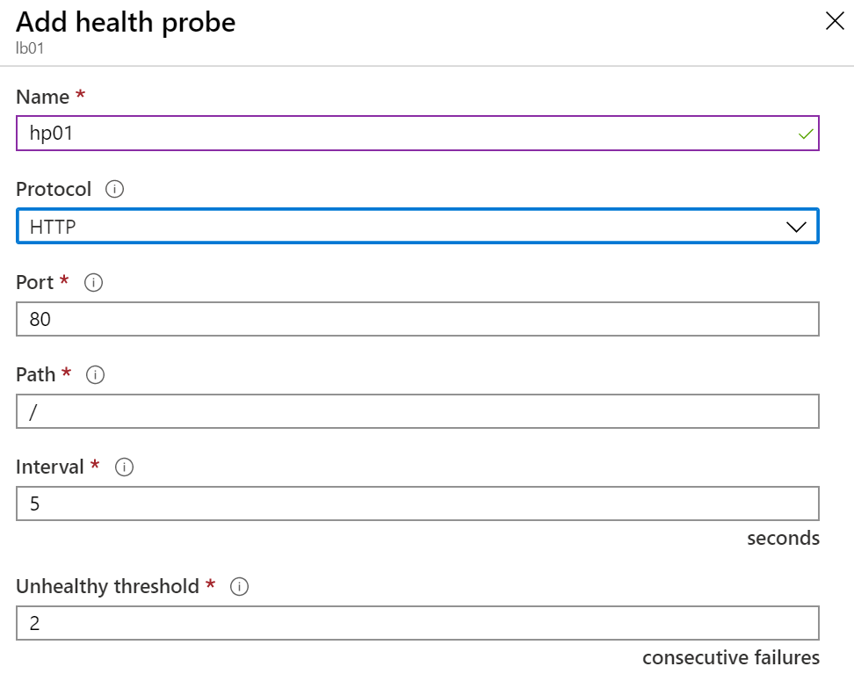
Health Probes
Allows the load balancer to monitor the status of an app
Dynamically adds or removes VMs from the load balancer rotation based on their response to health checks
HTTP custom probe (preferred) pings every 15 seconds
TCP custom probe tries to establish a successful TCP session
Notes:
✔ There is also a guest agent probe. This probe uses the guest agent inside the VM. It is not recommended when HTTP or TCP custom probe configurations are possible. Relate back to the original diagram to ensure all the components are covered.

Slide 13
Lesson 05: Module 06 Lab and Review

Slide 14
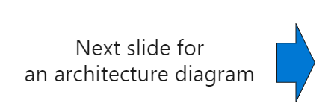
Lab 06 – Implement Traffic Management
Scenario
You are tasked with implementing a hub spoke topology for network traffic. The topology should include an Azure Load Balancer and Azure Application Gateway.
Objectives Task 1: Provision the lab environment Task 2: Configure the hub and spoke network topology Task 3: Test transitivity of virtual network peering Task 4: Configure routing in the hub and spoke topology Task 5: Implement Azure Load Balancer Task 6: Implement Azure Application Gateway

Slide 15
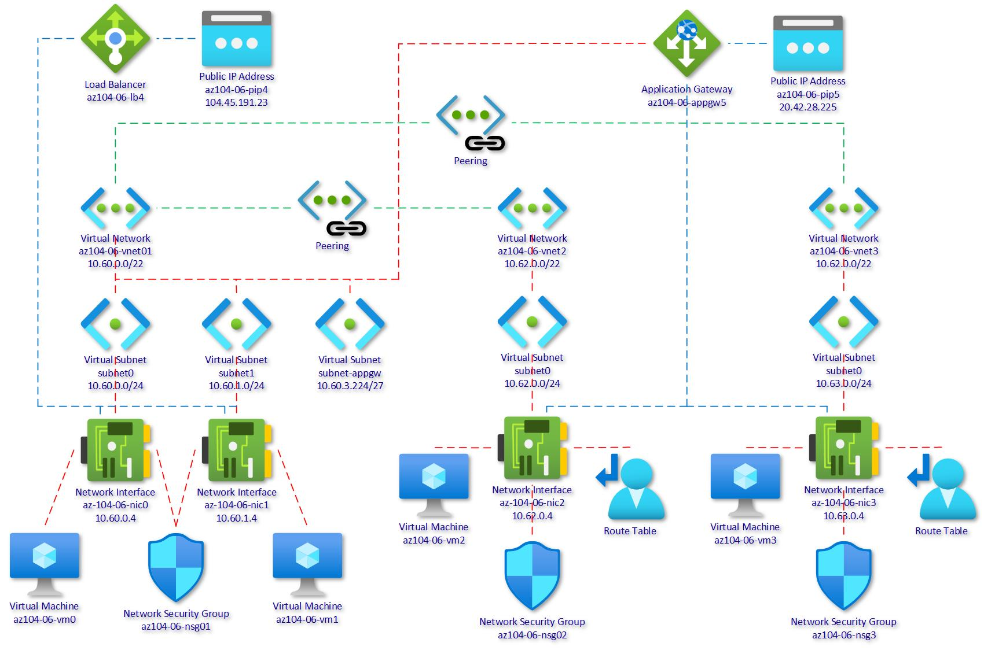
Lab 06 – Architecture Diagram
1
2
3
Notes:
Break down the explanation by reviewing the components in each of the three virtual networks.

Slide 16
Module Review
Module Review Questions
Microsoft Learn Modules (docs.microsoft.com/Learn)
Improve application scalability and resiliency by using Azure Load Balancer
Notes:
https://docs.microsoft.com/en-us/learn/modules

